Slide 1
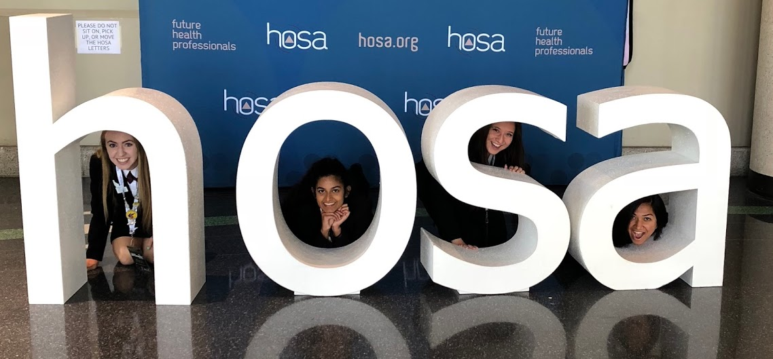
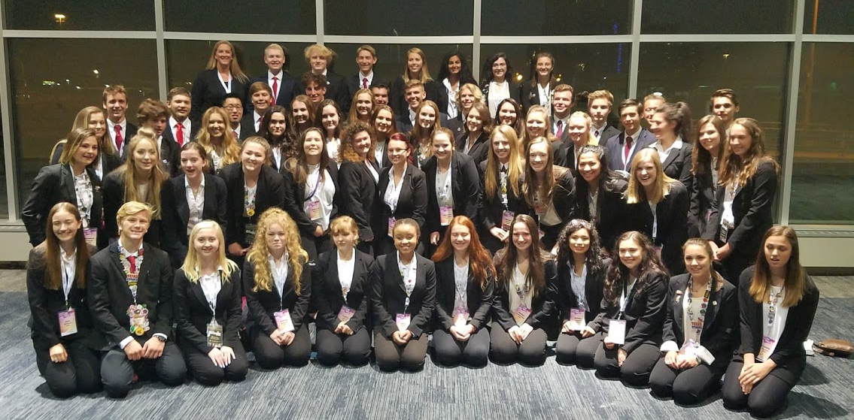
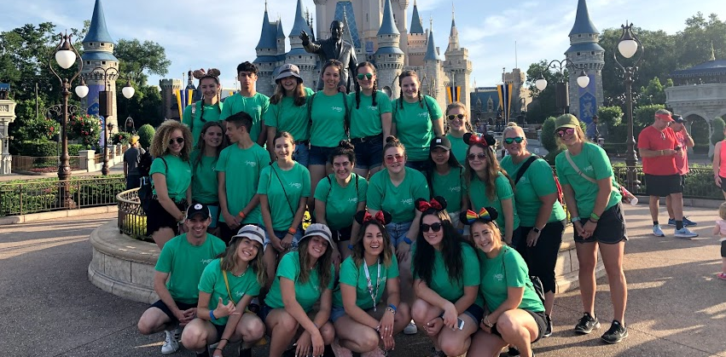
MMACHS HOSA

Slide 2
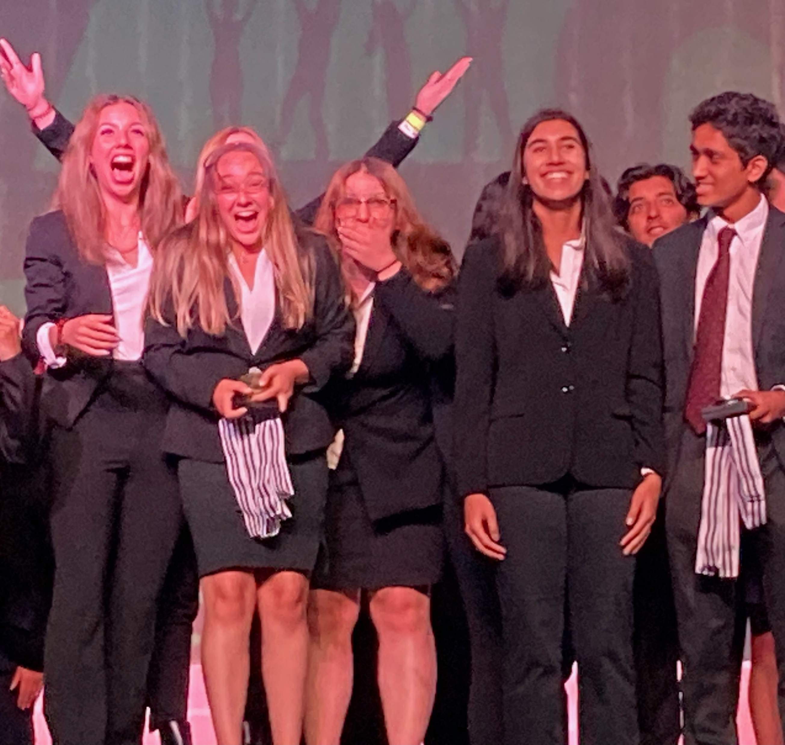
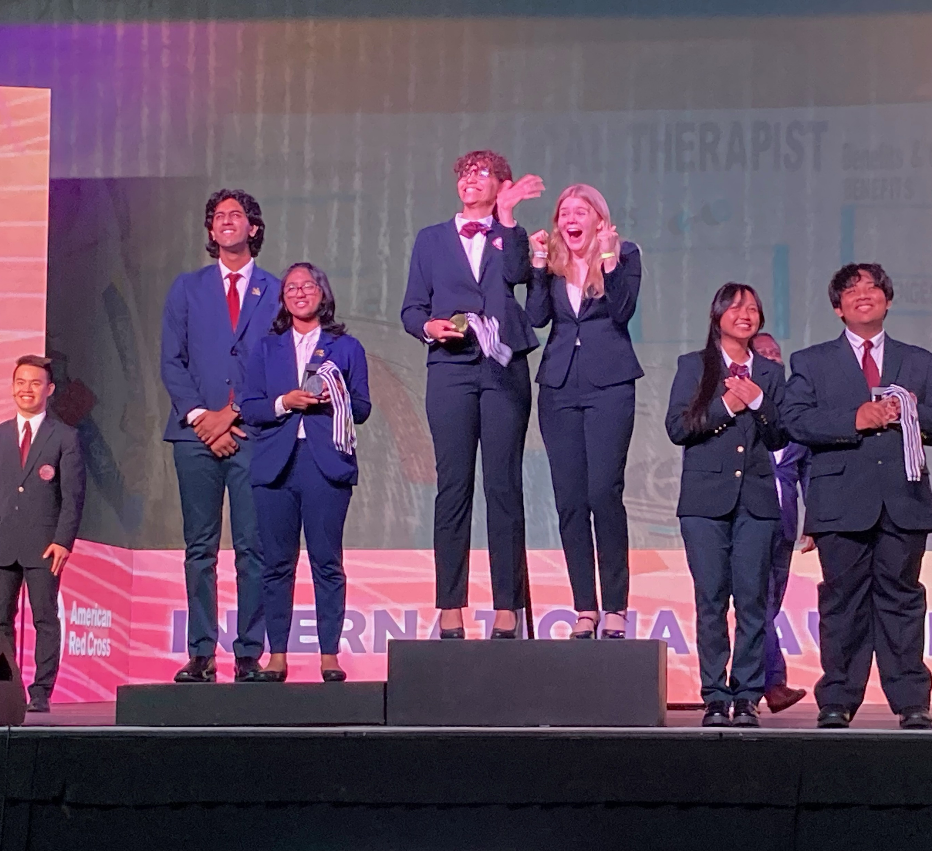
MMACHS HOSA
Student leadership organization that helps students explore different aspects of careers in the health-care industry.
50+ different competitive events
Largest HOSA Chapter in Idaho
70% of school
100 to130 students at SLC
50 to 60 students at ILC
$40 dues to join
Advisors:
Mr. Gaudet – gaudet.blake@westada.org
Mr. Skaar – skaar.Jonathan@westada.org

Slide 3
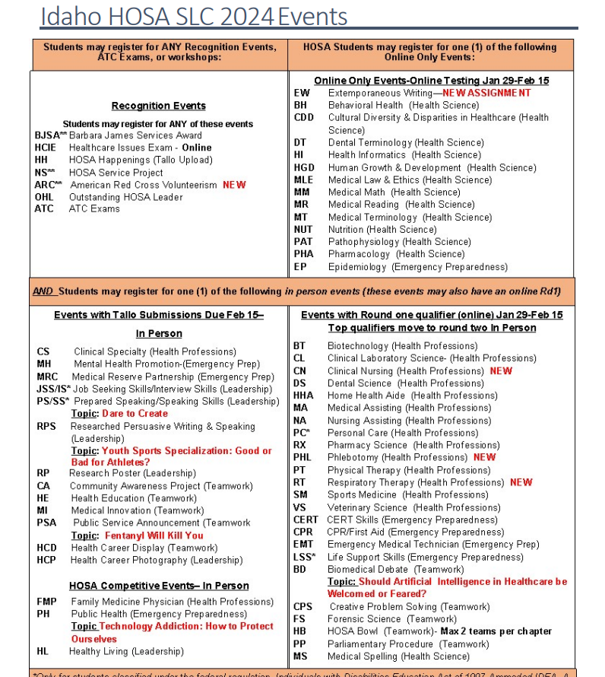
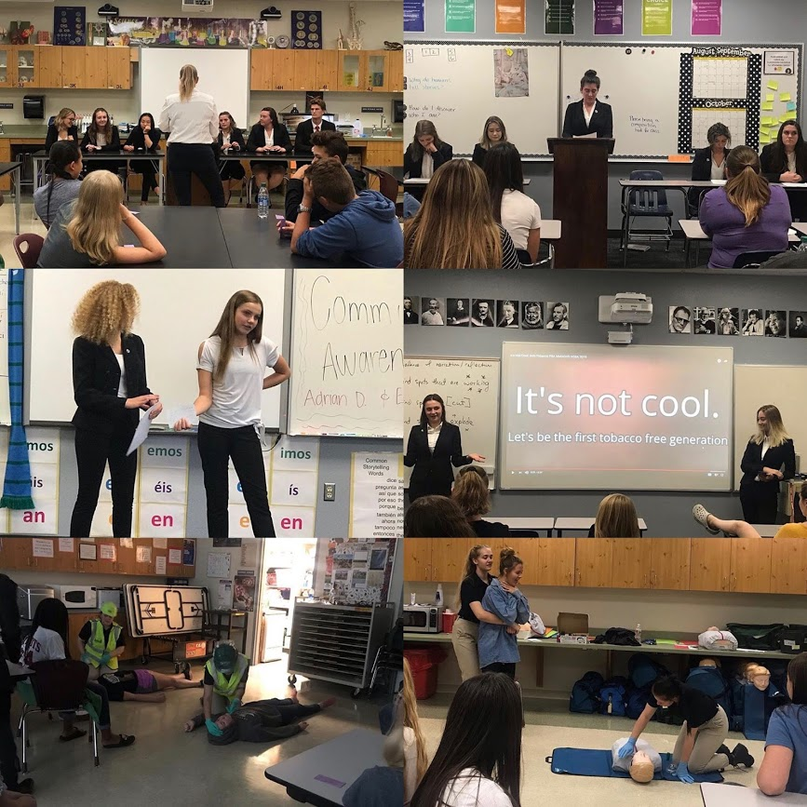
Event Selections

Slide 4
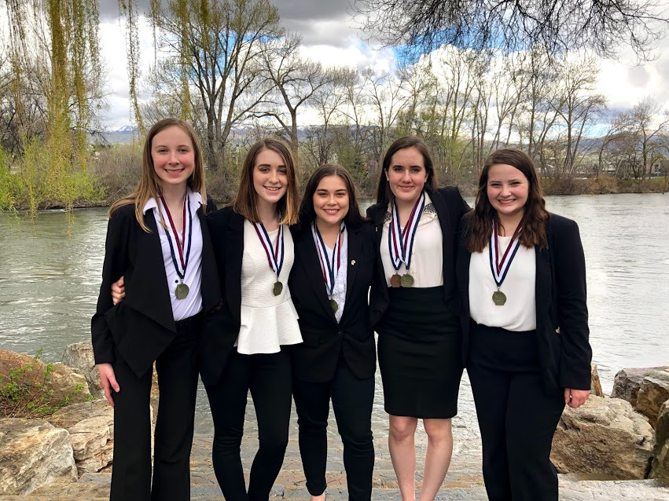
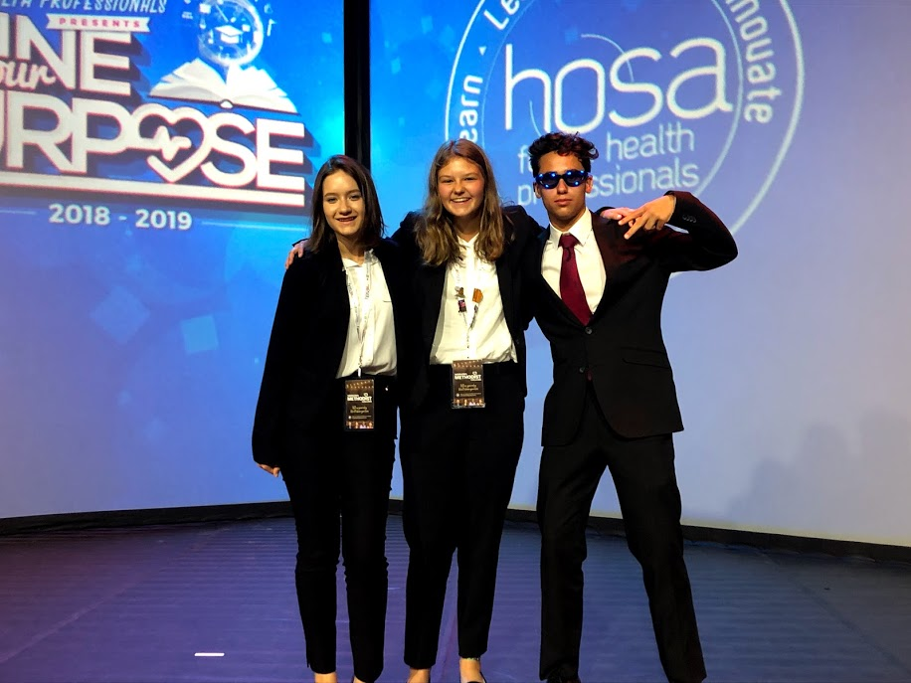
Dates for 2023-24
Regional Competition
Late January – MMACHS
Chance to practice event, see what where your strengths/weaknesses are
Idaho State Leadership Conference
March 5th – 7th
$100 (unless you sell 20 bags of potatoes)
Idaho State University – Pocatello, ID
International Leadership Conference (Optional)
June 17th – 22nd – Nashville, TN
Costs range from $850 - $1200 depending on flights, etc. Tons of fundraising opportunities through booster program.

Slide 5
HOSA Pro Dress
Female Attire
Navy Blue or Black Blazer
Navy Blue or Black Slacks
or Business Skirt
White Blouse
Navy Blue or Black Shoes
Male Attire
Navy Blue or Black Blazer
Navy Blue or Black Slacks
White Button Up Shirt
Red Tie
Navy Blue or Black Shoes

Slide 6
How do I know what is expected of my student?
Read over their guidelines!
Link: http://www.hosa.org/guidelines
Click on their event to see details of their competition
How can I help my student succeed?
Encourage them to study or practice in small doses spread apart (no cramming!)
Act as a test audience before their competition
Help them find the resources they need to complete (books, portfolios, posters, etc).
BECOME A BOOSTER! (more info on this later)

Slide 7
HOSA Boosters

Slide 8
MMACHS HOSA Boosters

Slide 9
MMACHS HOSA BOOSTERS
We are essentially the “PTA” of Meridian Medical Arts MMACHS students work hard and set big goals for themselves. We want to encourage and support them in their journey.

Slide 10
We meet the
2nd Tuesday of each Month
Our Next Meeting is
Next Tuesday September 10, 2024 @ 6:30
MMACHS - Social Center
No commitment – Just come say hi, come to volunteer when needed, or come just to know what is going on.

Slide 11
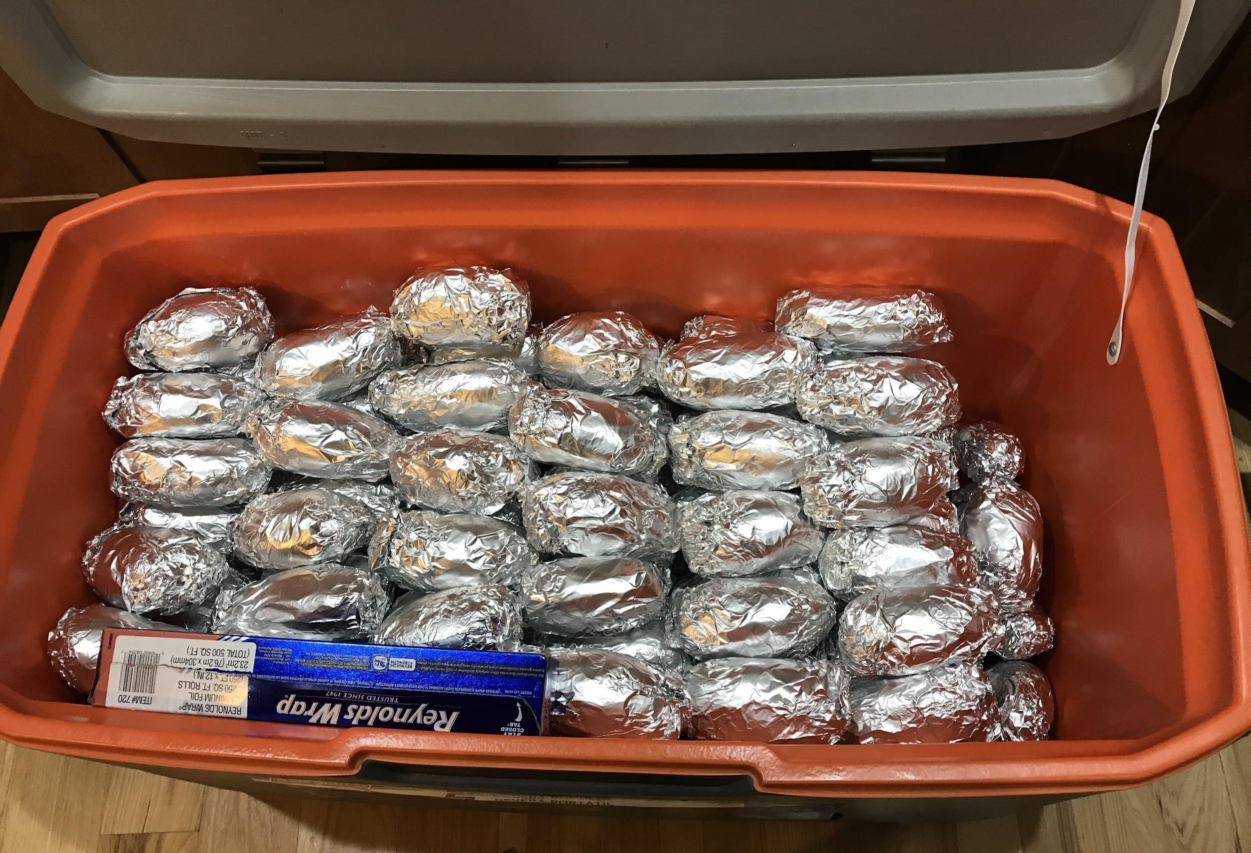
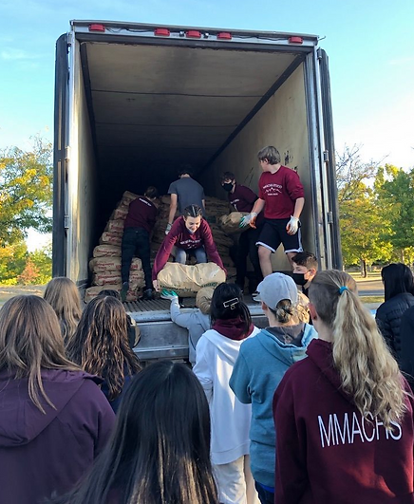
We are additional support for our MMACHS students and families Not everything is HOSA, :)
Student events and Volunteer Fun
Potato Feed
Halloween Haunted House
Holiday Bazaar
Social Nights/Activities
Teacher Appreciation
Notes:
Boosters support Back to School Night.
We use it to share who we are as a club
Welcome new families and faces
Increase parent involvement.
kickoff our Spud-Raiser event.
* this year we were cancelled due to pandemic restraints.

Slide 12
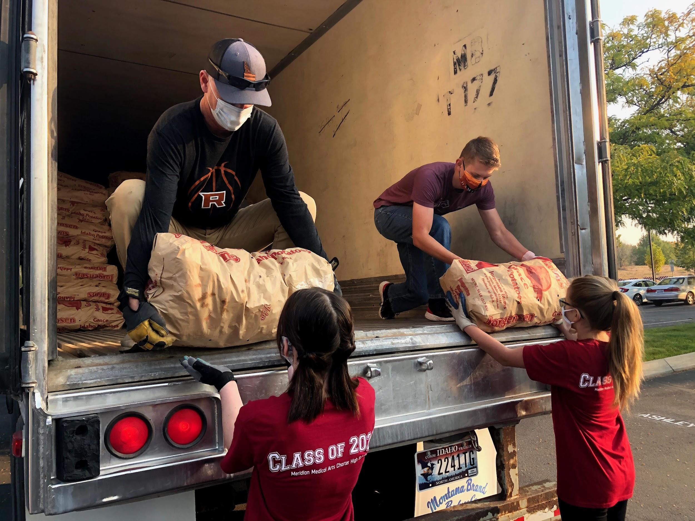
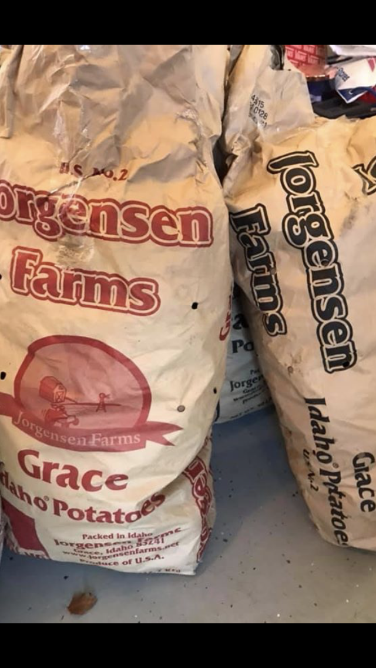
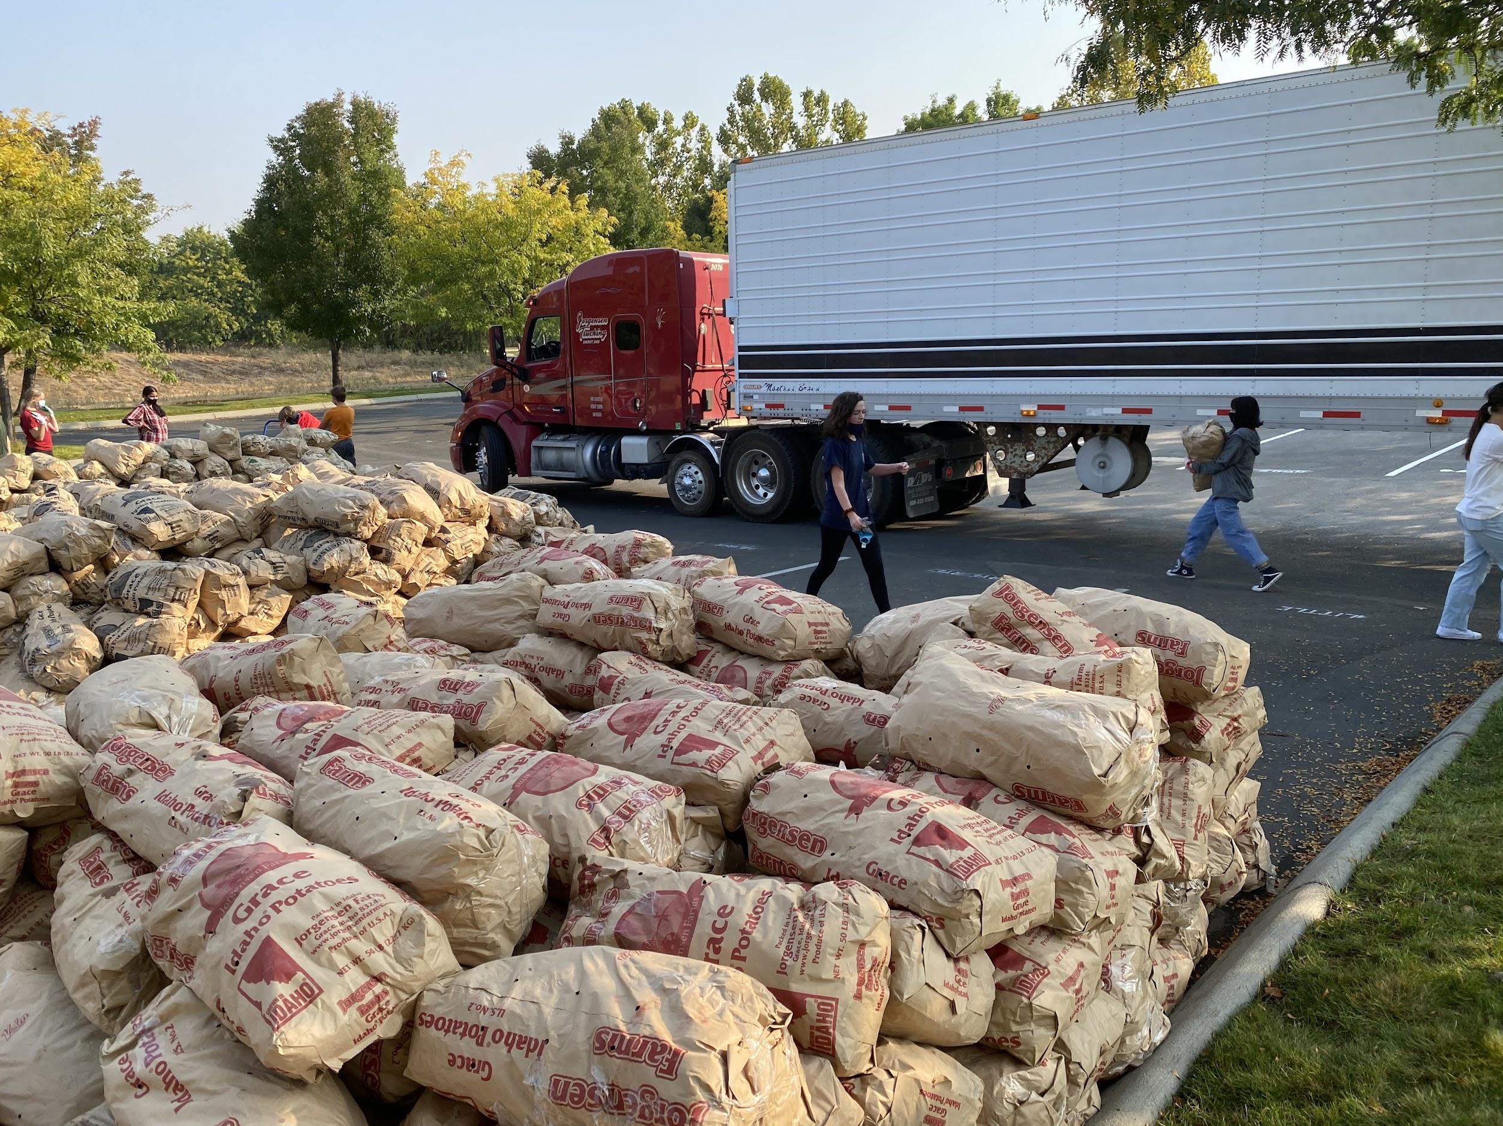
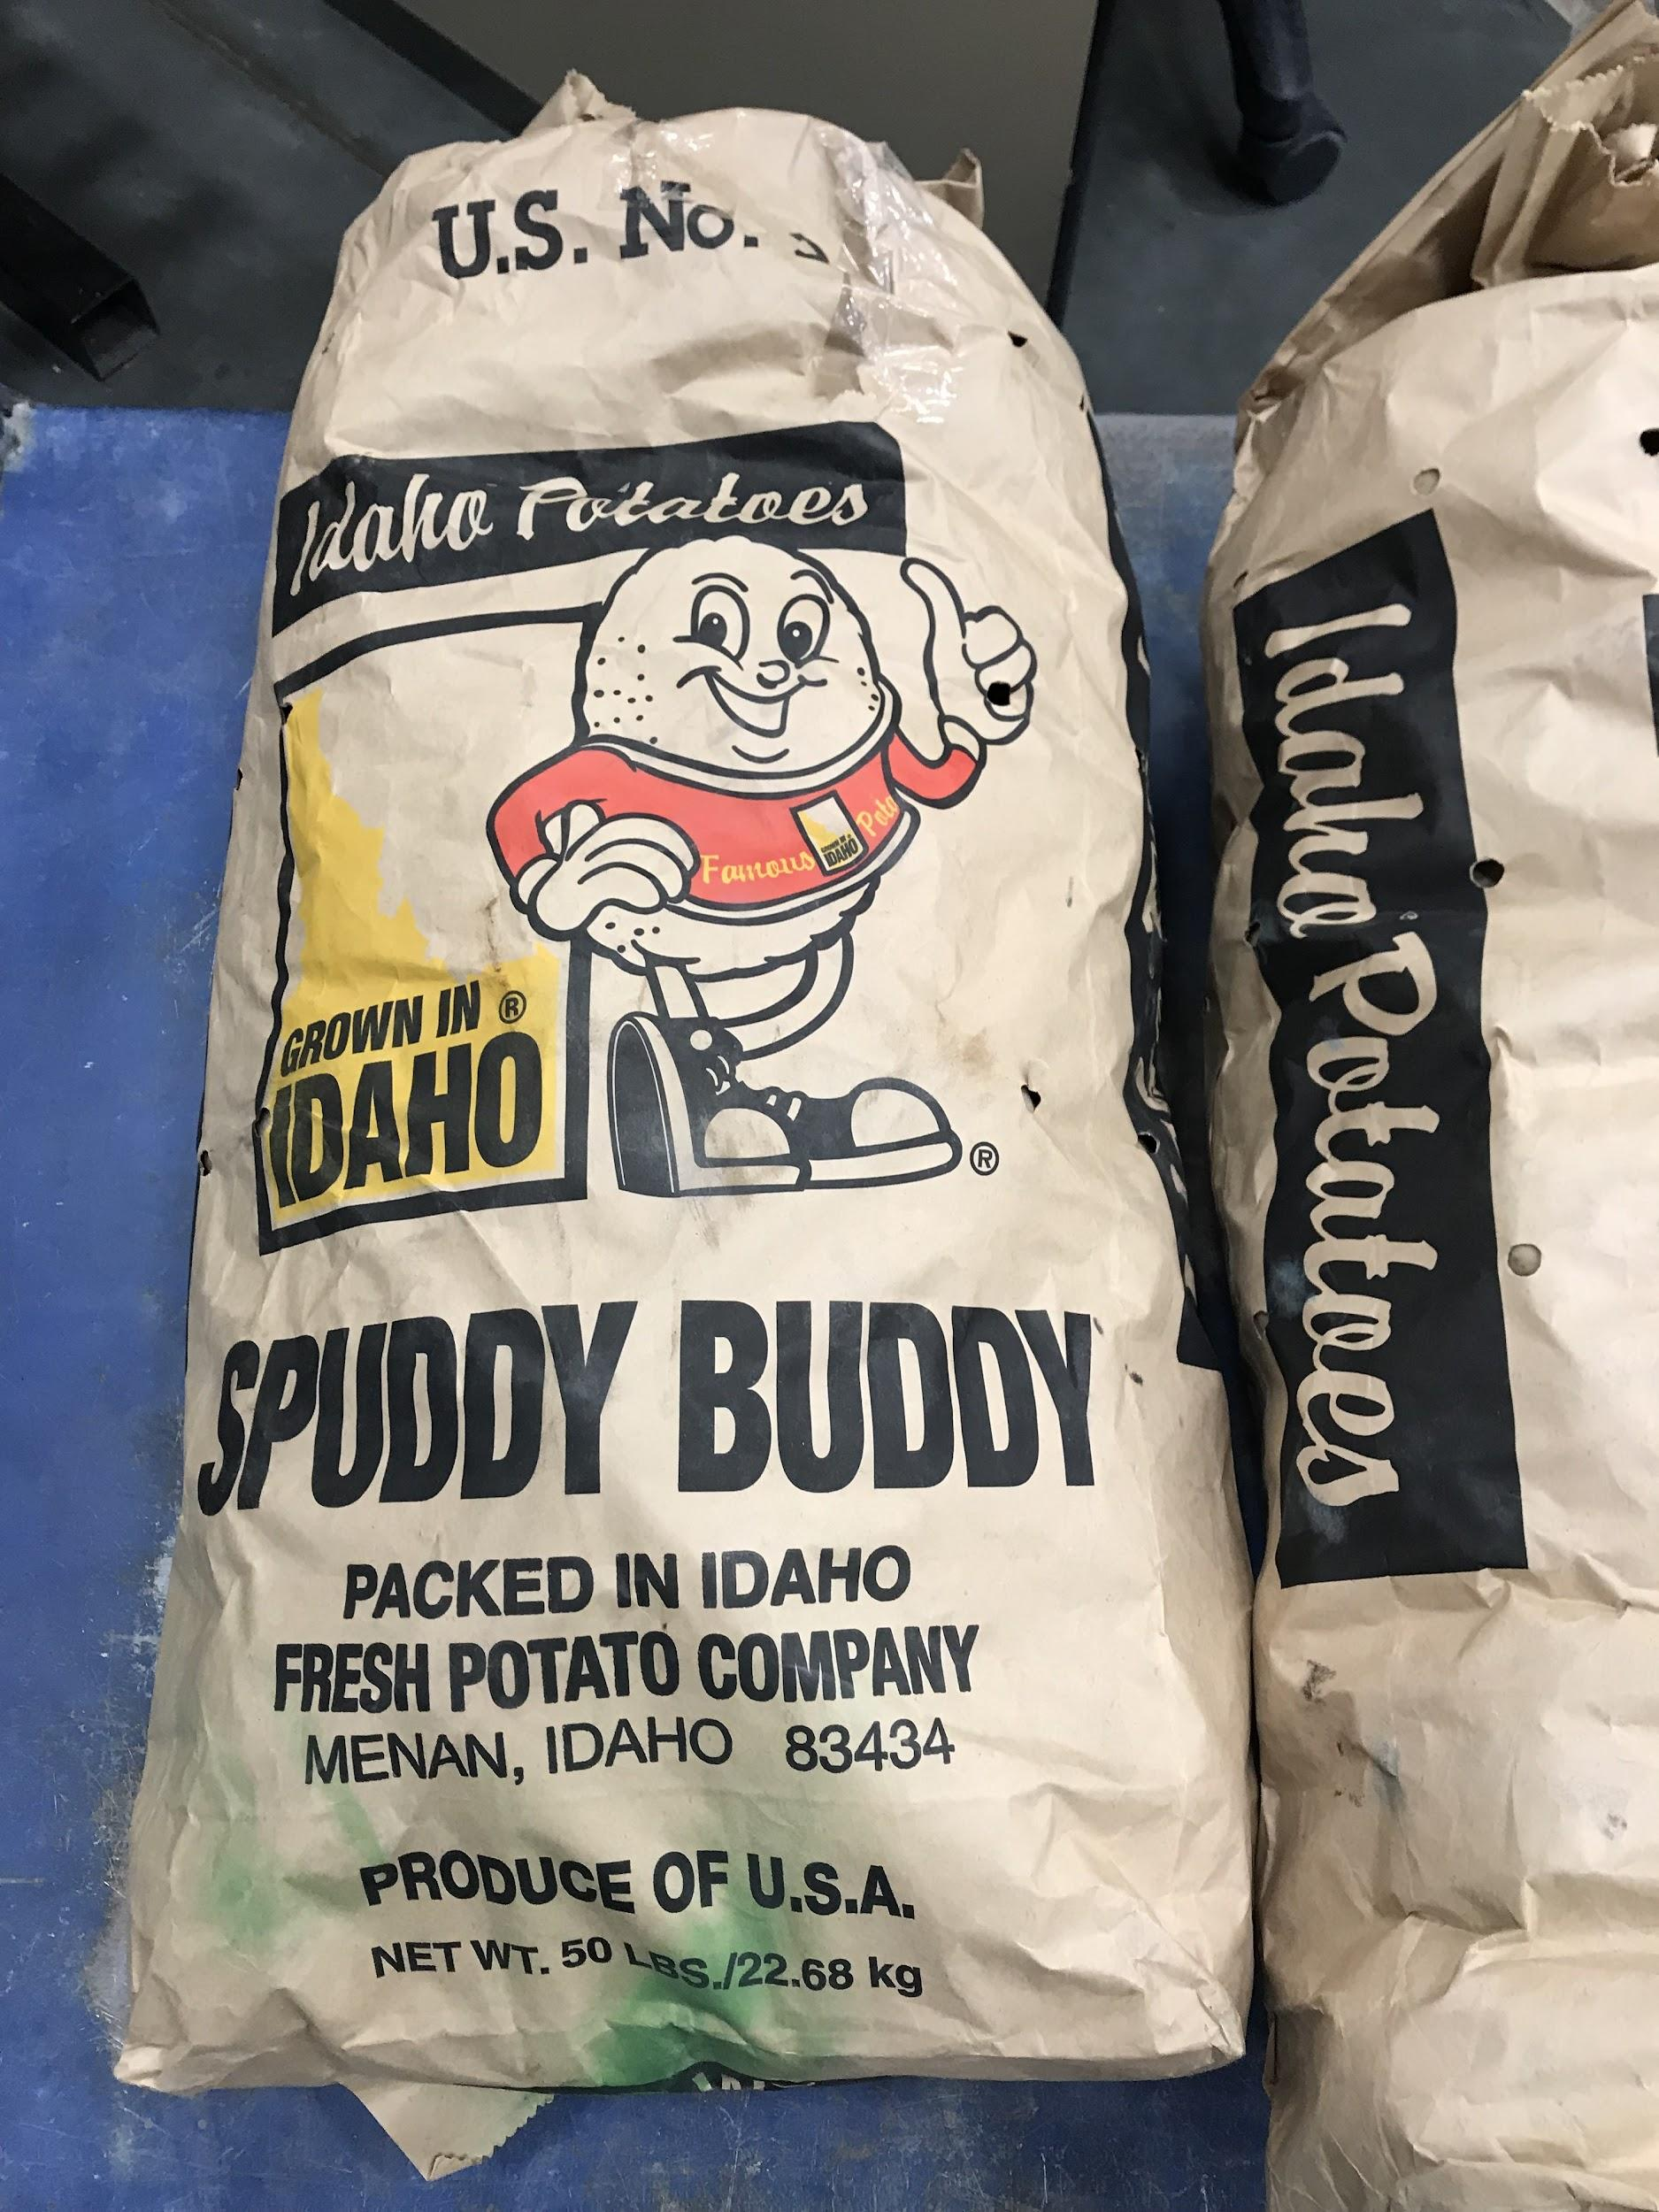
Fundraising- Where does that money go?
Approx. 40 Students
Received FREE State Leadership Competition (SLC) fees by selling a minimum of 20 bags of potatoes at the 2023 fundraiser.
This equaled $4,000.00 in student scholarships!
proceeds are applied towards:
Scholarships
Meals and snacks
Transportation
Special event prizes
Event needs
Teacher appreciation

Slide 13
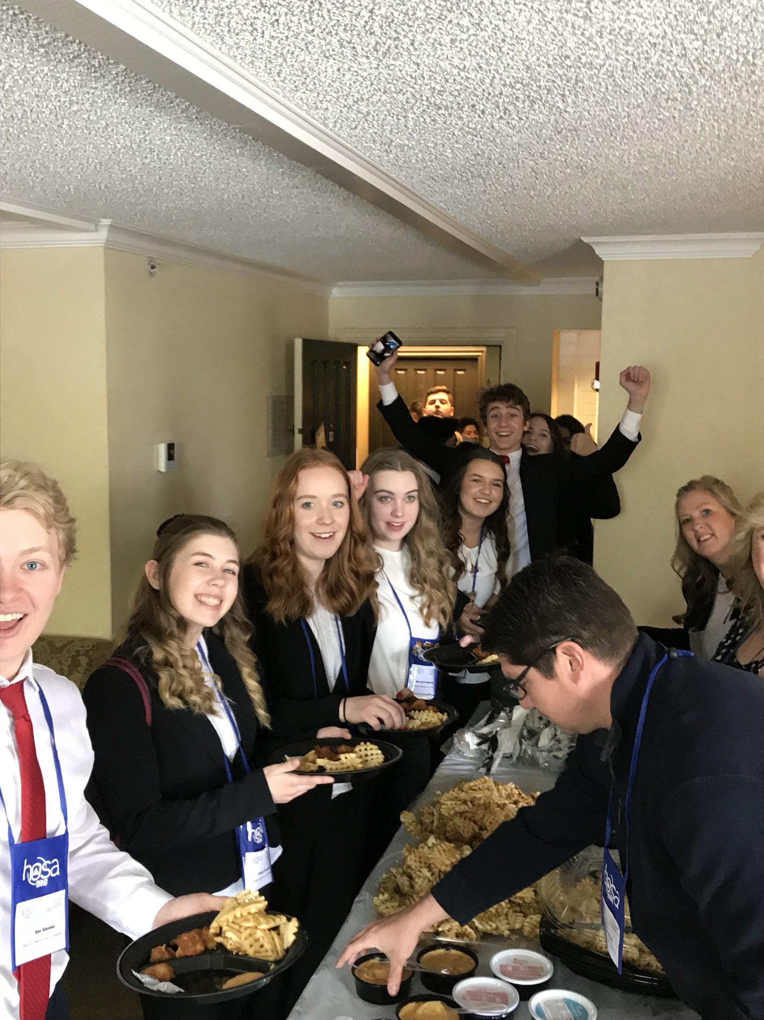
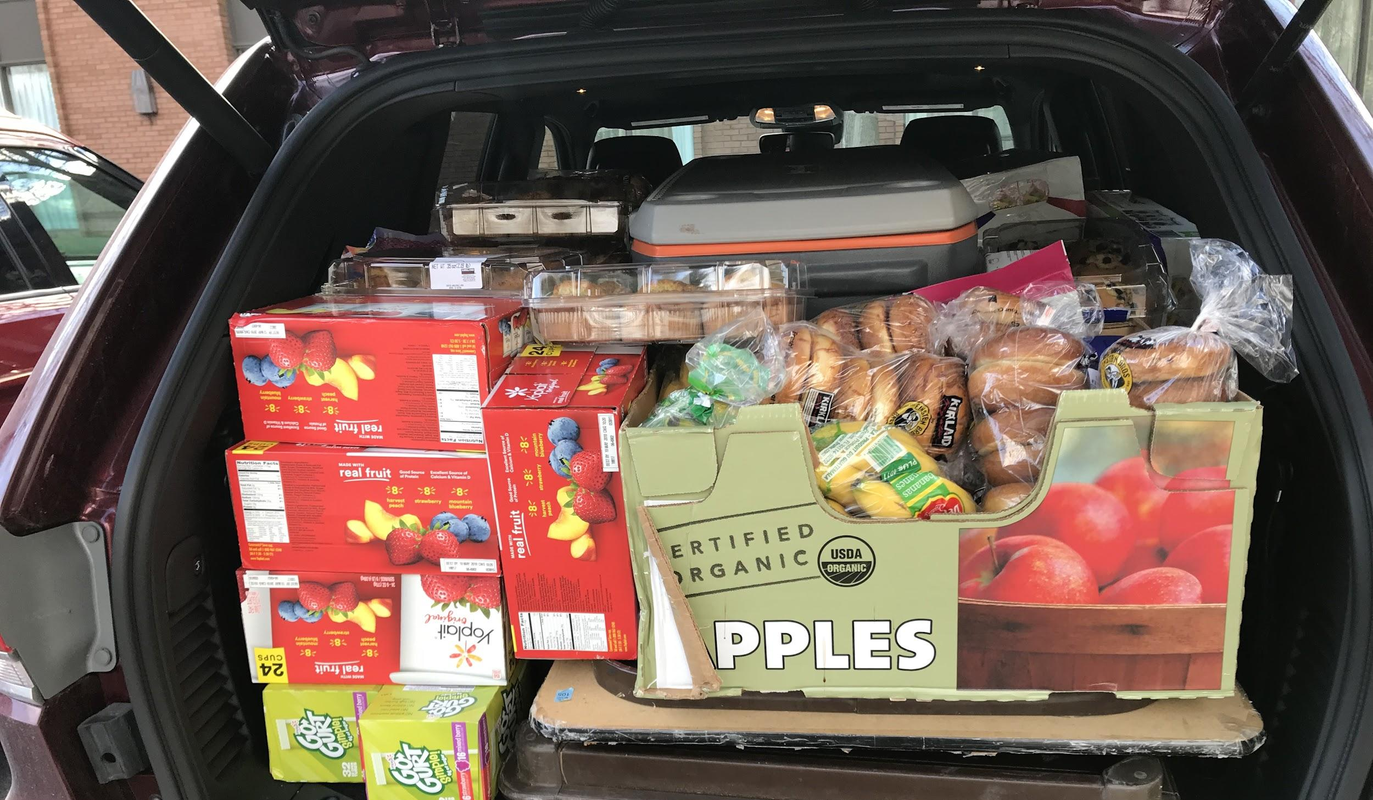
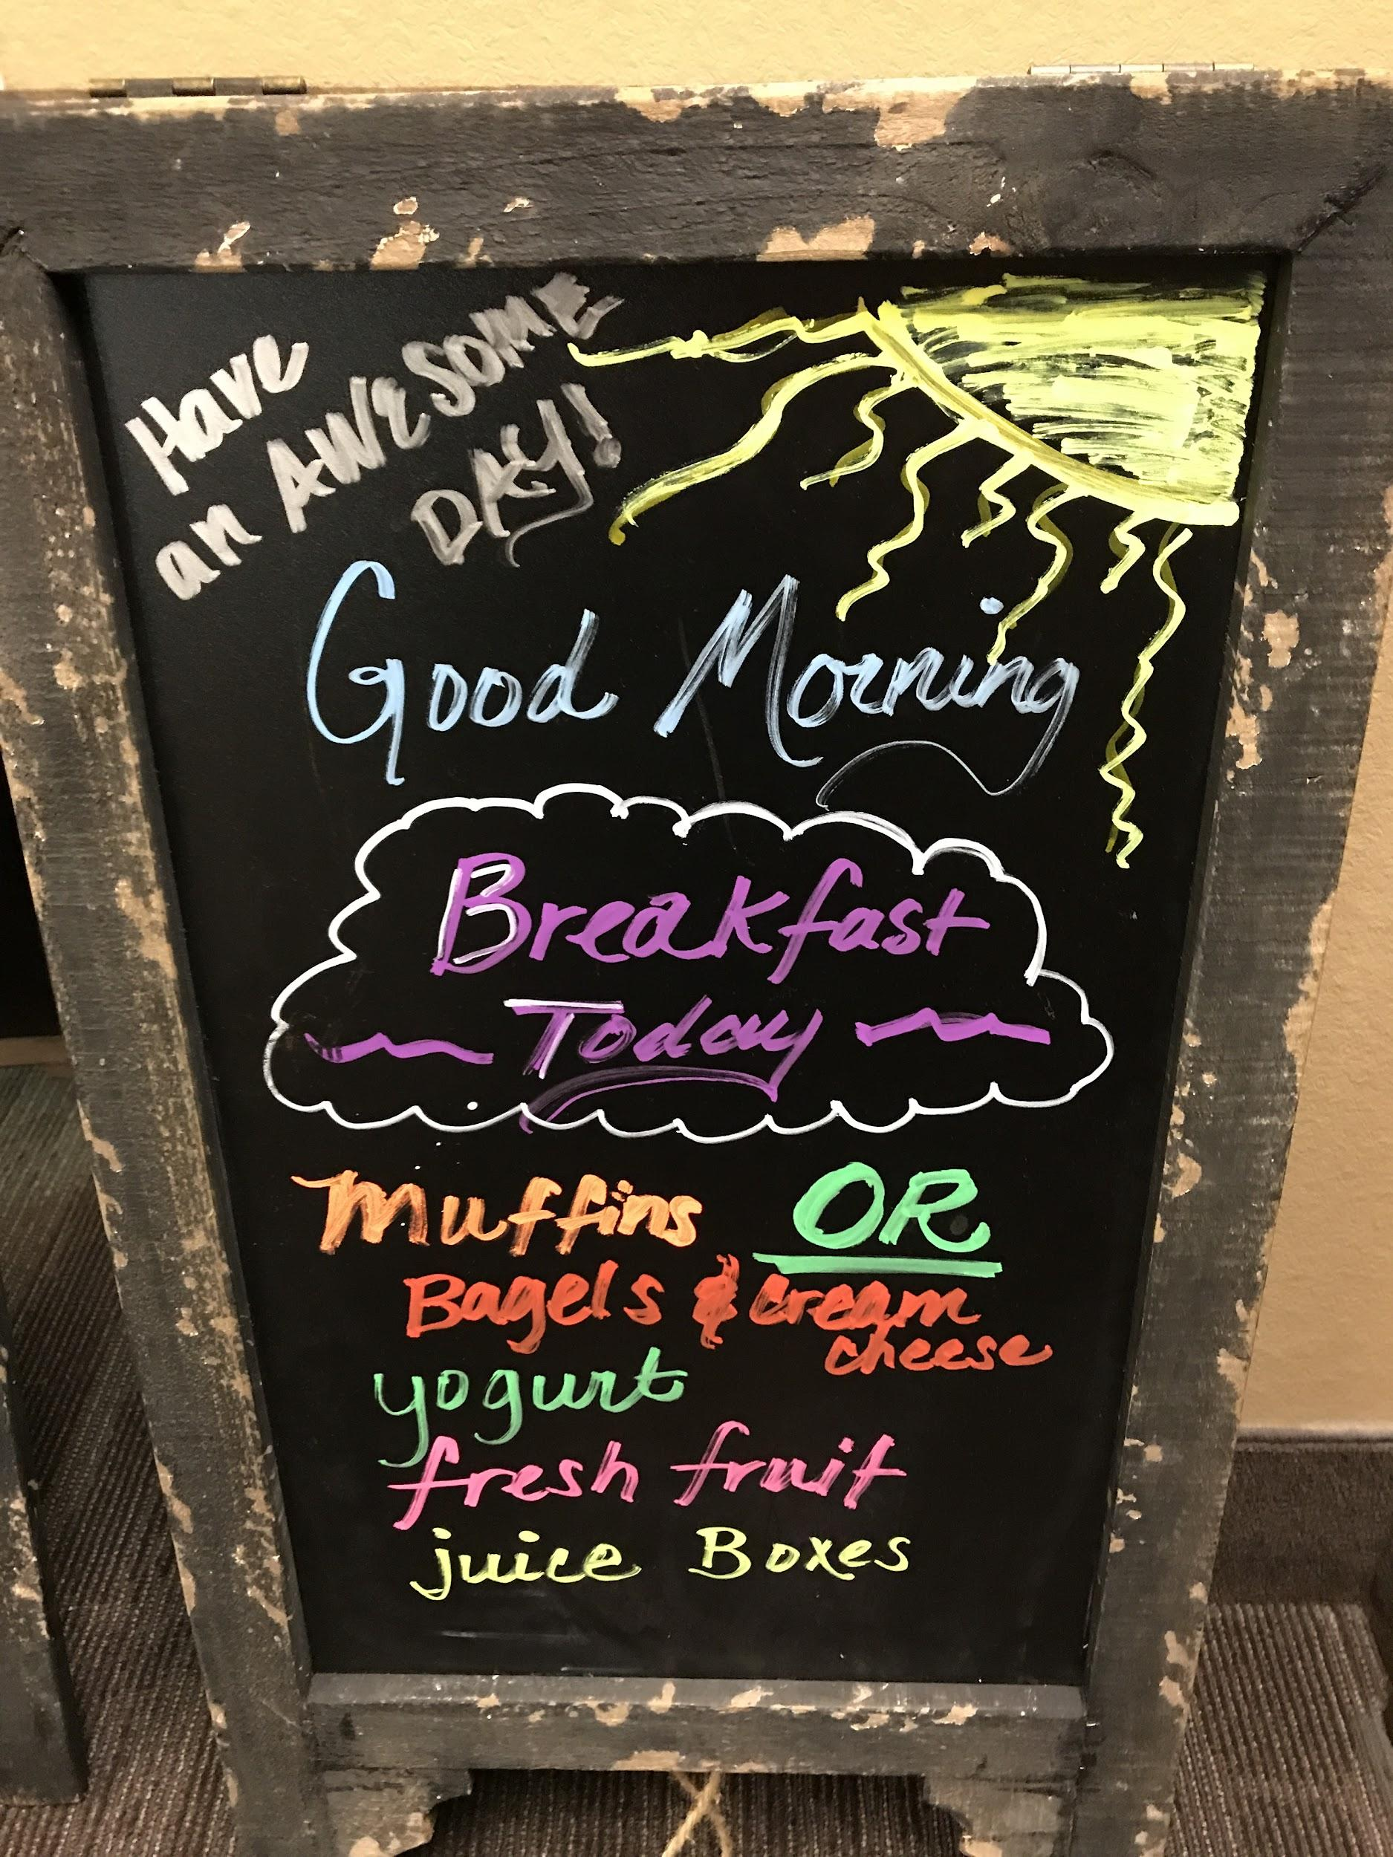
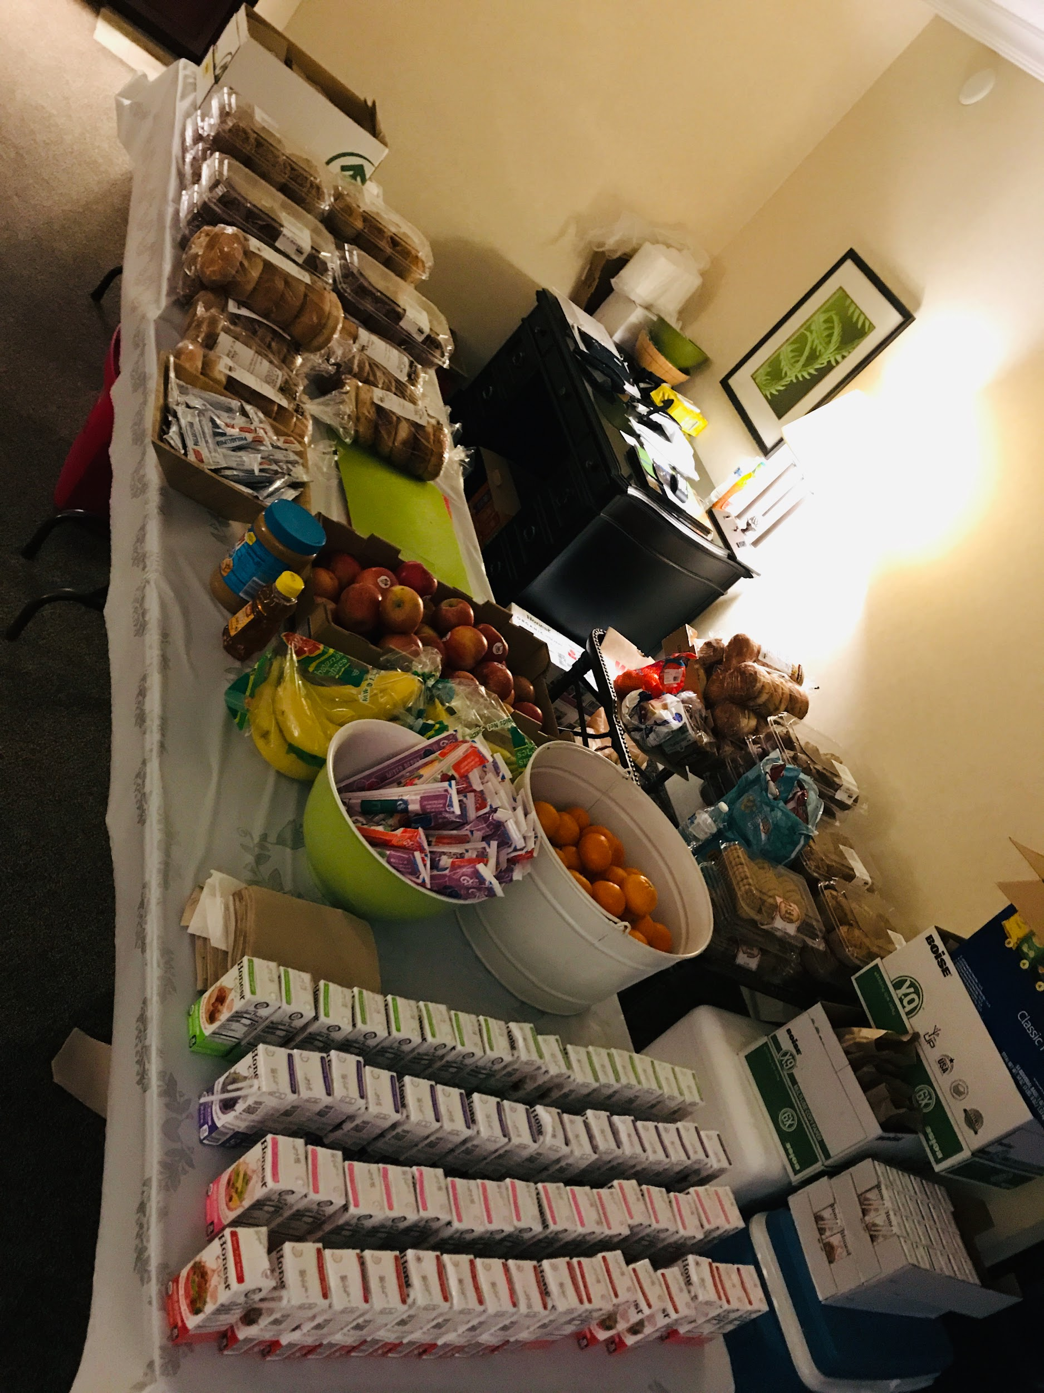
Meals and Transportation!!
Boosters help the most by Feeding the masses when at events! We provide meals, snacks, staff support and sometimes transportation.

Slide 14
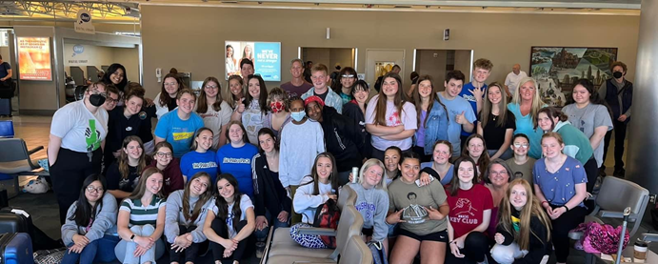
How can you support MMACHS HOSA?
Volunteer help for HOSA events, watch for newsletter, attend meetings, watch for signup genius and email us, bring IDEAS!

Slide 15
Notifications
Come to meetings
2nd Tuesday at 6:30
Sign-up Genius
Watch for Monthly Newsletter
Volunteer at events
Food Needs
Website
mmachshosaboosters.org

Slide 16
Leave a message with the school or Teacher advisors
Mr. Gaudet
mmachshosaboard@gmail.com
Ways to contact us?

Slide 17
Questions?

